Slide 1


SUB Broadcasting System
Project #8

Slide 2

Problem Statement
Teams need to communicate with various groups by broadcasting and cascading messages across the organization.
Notes:
We decided to create a broadcasting system to allow one user to broadcast a message across multiple distribution groups.
Any member who is subscribed to one of the distribution groups will receive the message.
The messages sent can be designated as confidential or public.
The graphical user interface was designed to help the user experience.
It is compatible on both phone and pc formats which
This broadcasting system provides and intuitive and efficient way to safely transmit messages across multiple parties.

Slide 3
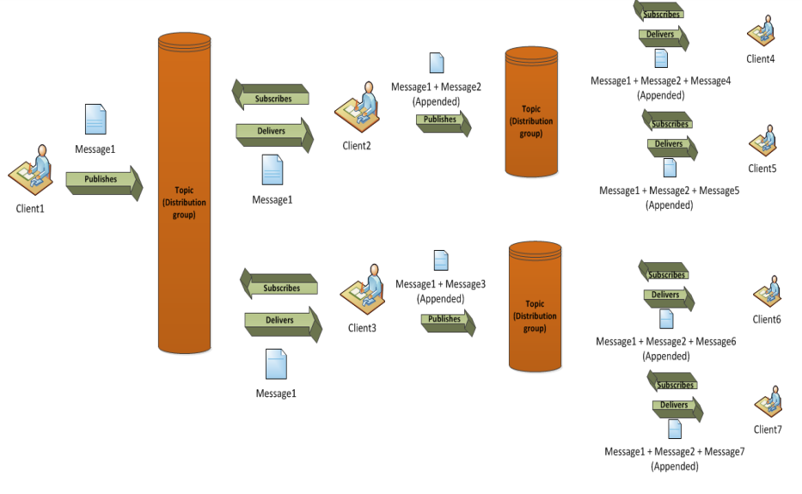
Notes:
SUB - how deep the levels

Slide 4
Our Mission
Members can subscribe to specific distribution groups or “teams”
Allow an important message to be broadcasted across multiple subscribers
Message can be sent as public, private, confidential, or specific

Slide 5
What We Used
NodeJS
Node Express
Socket.IO
AngularJS 2.0
TypeScript/JavaScript

Slide 6

User experience
User friendly
Compatible on mobile and pc
Displays statistics

Slide 7
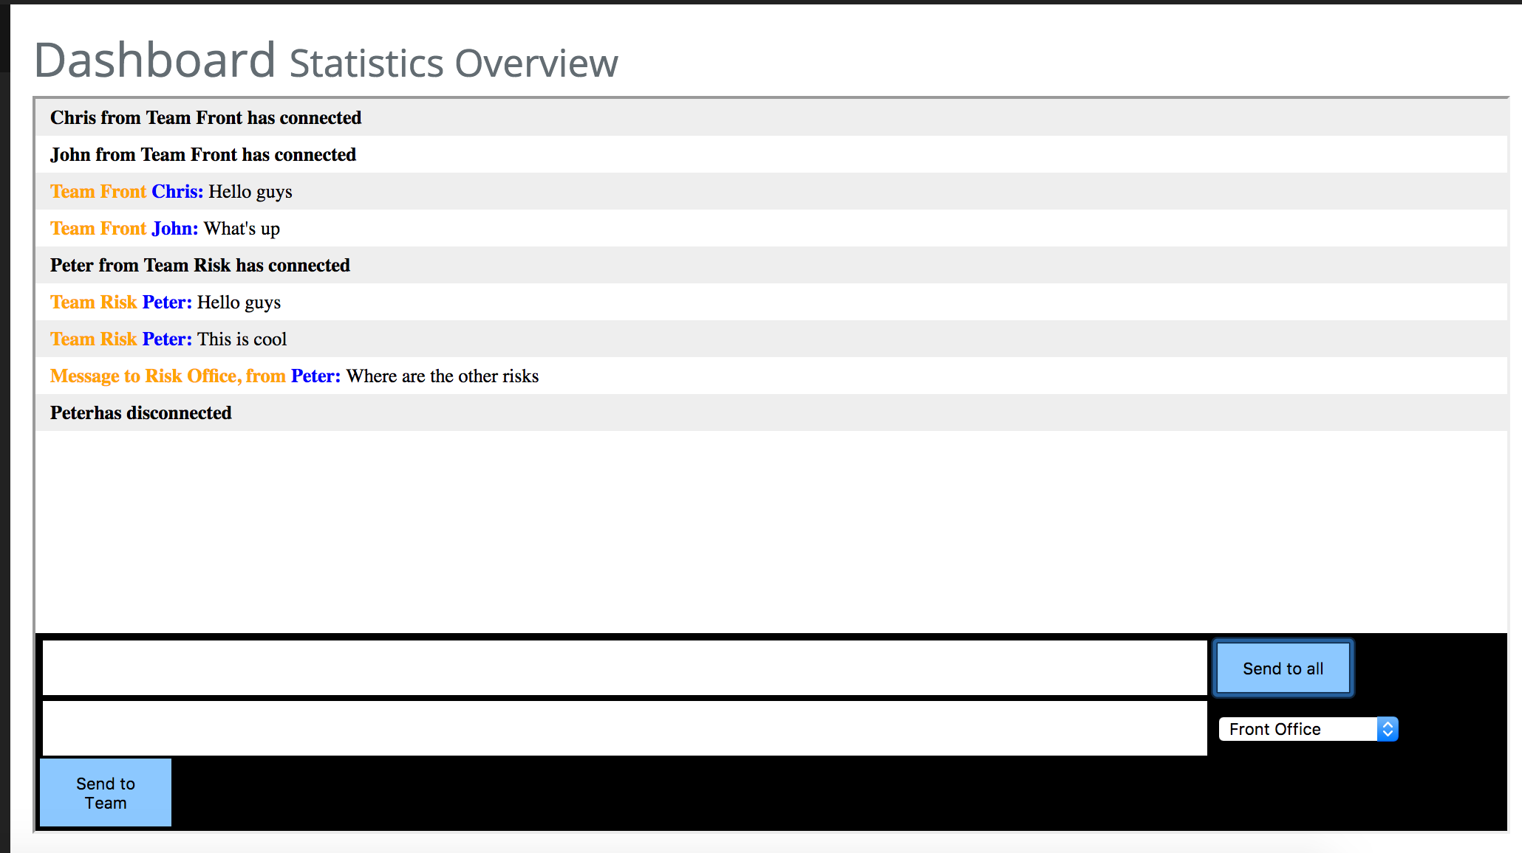
Notes:
Open application

Slide 8
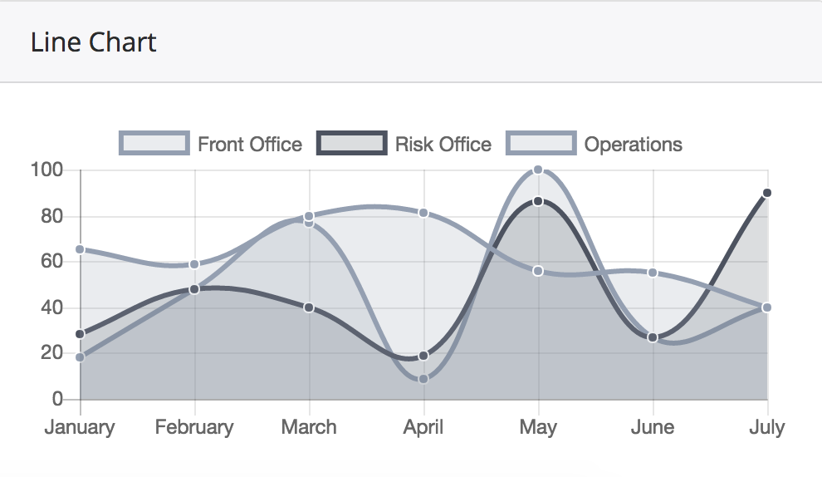
Notes:
Open application

Slide 9
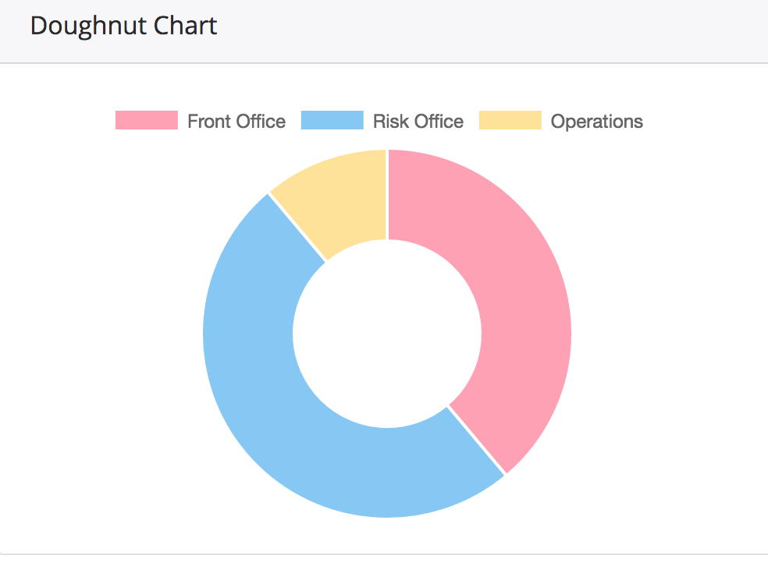
Notes:
Open application

Slide 10
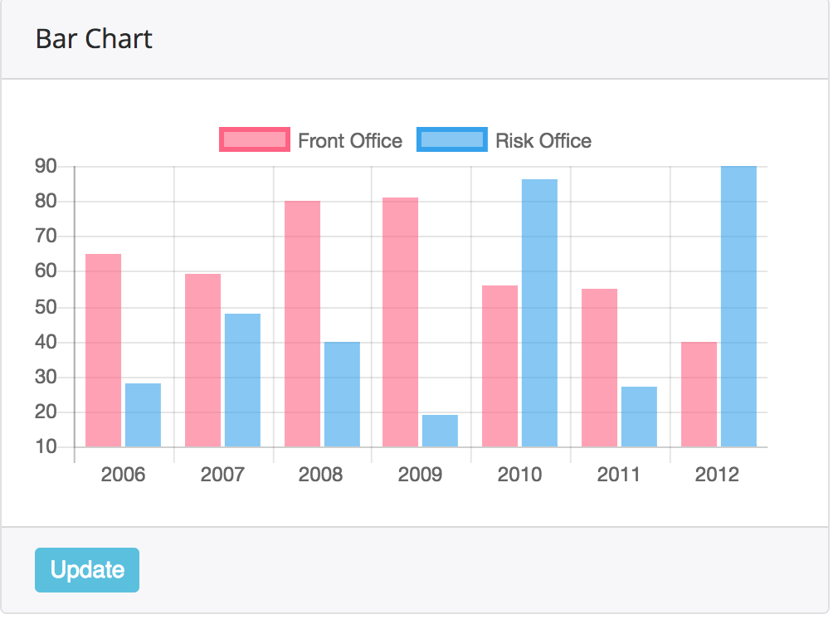
Notes:
Open application

Slide 11
Demo
Notes:
Open application

Slide 12

Key Advantages
Scalable
Broadcast different types of multimedia
Prioritize and segregate messages based on sensitivity
Instantly publish to many groups
Hierarchy
Threaded messages
Can be used for trading floor

Slide 13
Enhance to next level
Include hierarchy of distribution groups
Encrypt messages
Support different types of multimedia
Apply Machine Learning

Slide 14
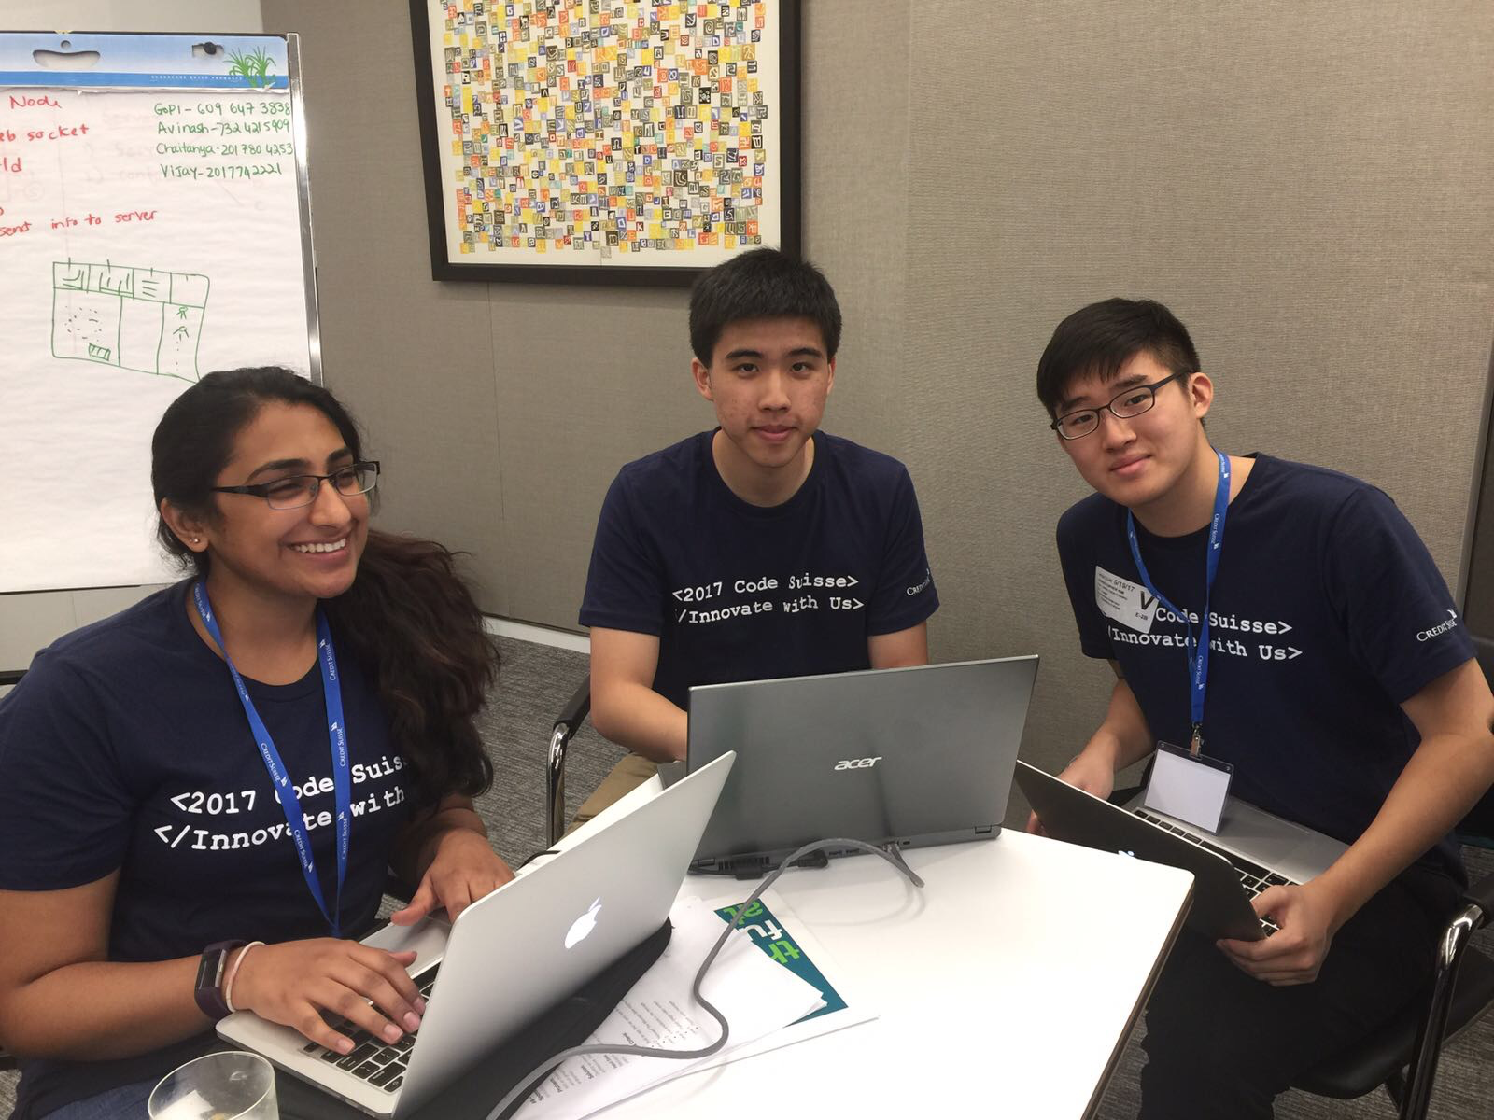
Thank you!
Notes:
Open application

